Slide 1
Screening and Interviewing
Pub 4012 – Tab B
Pub 5101 – Intake/Interview And Quality Review Training

Slide 2
Engage the Taxpayer
Put taxpayers at ease
Build rapport
Introduce yourself with a smile
Engage in small talk
Ask open-ended questions
Questions that require more than yes or no answers
This is not an adversarial relationship
Notes:
Remember – for some this will be a difficult, trying experience
Giving their personal confidential information to a stranger
Will they owe more than they can afford
Will they get the refund they hope for
May have physical limitations

Slide 3
Engage the Taxpayer
Speak clearly
Allow taxpayer time to respond
Protect taxpayer privacy
Let taxpayers explain in their own words
Don’t be afraid to say, “I don’t know”
Always ask permission to discuss taxpayer information with another counselor

Slide 4
Explain the Process
Will go over the Intake Booklet, all taxpayer tax documents, and prior year return
Both will and can ask questions
Return will be prepared
Return will be reviewed by another counselor
Explain reviewer will ask some of same questions for verification
Taxpayer/spouse will sign return
Return will be E-filed or taxpayer will mail return
Explain state specific procedures
Notes:
Make sure taxpayer understands the steps you will follow that lead to his/her return being completed
Review of Intake Booklet and documents and last year’s return to make sure have everything and return is in scope
Data entry in TaxSlayer – will likely have questions as go through this
Your review of completed return with taxpayer – he/she knows better than anyone if spellings are correct, addresses correct, etc. plus chance to answer any questions
QR by a second set of eyes to make sure everything is correct
Will give copies of returns to taxpayer for their records
Will efile federal and state returns (unless there is a tax law related reason not to – we don’t prepare paper returns otherwise)
Will give them any local returns to mail if necessary

Slide 5
Confirm Taxpayer Identity
Confirm identity of taxpayers with government-issued photo ID
LC approval required for exceptions
Confirm taxpayer identification number for every person listed on return
Social Security card or 1099-SSA benefits statement
ITIN letter
LC approval required for exceptions
Notes:
Be cognizant of IDENTITY THEFT!
Screening may be done initially by the client facilitator, but the trained counselor must ALSO complete this step.
If taxpayer and spouse are known by counselor and identity can be verified by counselor, that is acceptable.

Slide 6
Screening and Interviewing
Thorough screening and interview required prior to starting return
Review all 8 pages of Intake Booklet with taxpayer
Ensure return is in scope
Ask questions when situation unclear
Exercise due diligence
Discuss/review three new consents and questions
Notes:
Good interview can determine if return is in scope
Saves taxpayer and Counselor time+

Slide 7
Intake Booklet
Comprised of 8 bound pages:
Pages 1-3: IRS Interview/Intake Sheet
Page 4: Global Carry Forward Consent Form
Page 5: Relational Offices Consent Form
Page 6: Divider/Instructions Page
Page 7: Custom Questions
Page 8: Information Sharing with AARP Foundation Consent Form

Slide 8
Intake Booklet
First three pages similar to prior years
Counselors complete gray shaded areas
Discuss and change all “Unsure” to “Yes” or “No”
Review Intake Booklet for out of scope items
Add notes on Intake Booklet of any additional information to assist quality reviewer
Notes:
This is not an option – REQUIRED for each taxpayer/couple/family
Some taxpayers may have difficulty answering all the questions.
Client Facilitator (if you have one) can help
You will help as you review all questions and entries

Slide 9
Intake Booklet
Sort taxpayers’ documents for sources of income and expenses
Confirm needed documents or information is present
Taxpayer may need to go home for missing information
Verify tax year
Review for scope
AARP TaxAide Scope Manual
Notes:
The counselor’s job is not just to input the taxpayer’s documents – it is to ensure they are preparing an accurate and complete tax return for the customer.
Not uncommon for taxpayers to mix multiple years of documents, so be sure have this year’s
Sort in Form 1040 order and leave in order so that QR person doesn’t have to hunt

Slide 10
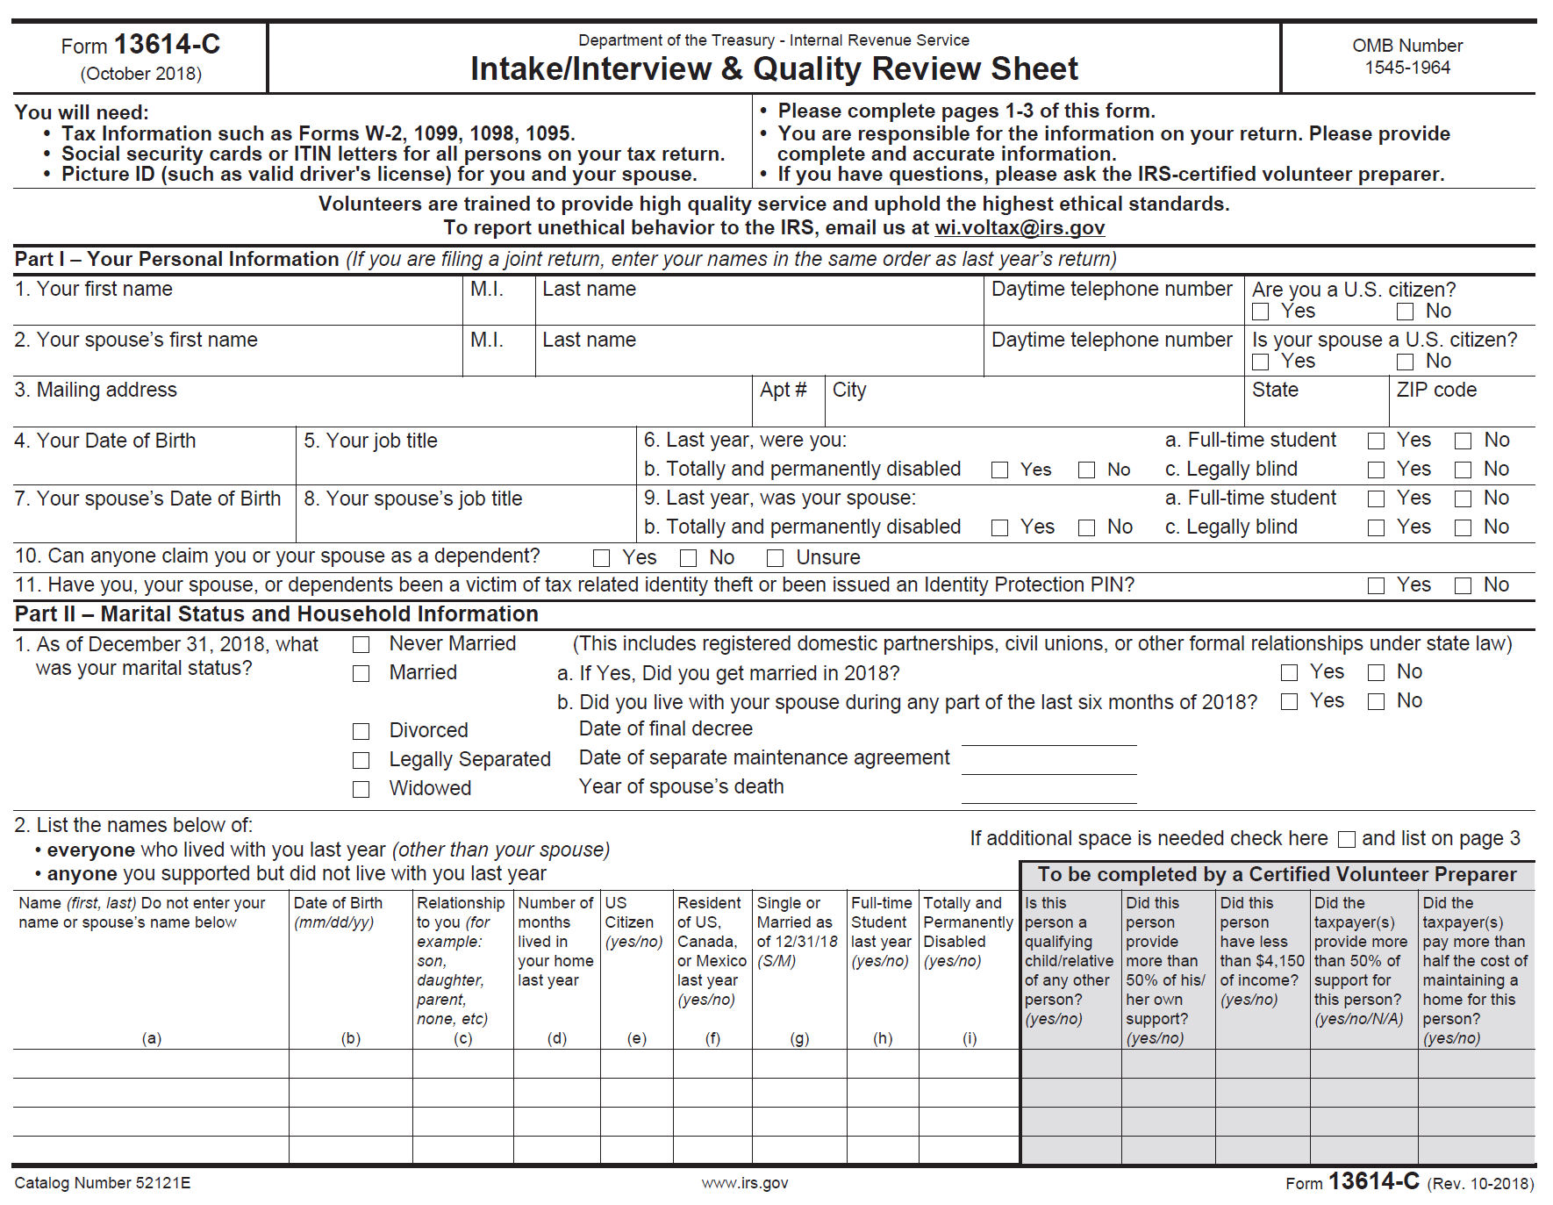
Intake Booklet Page 1
Counselor to complete shaded area
Notes:
Rarely see this completed!

Slide 11
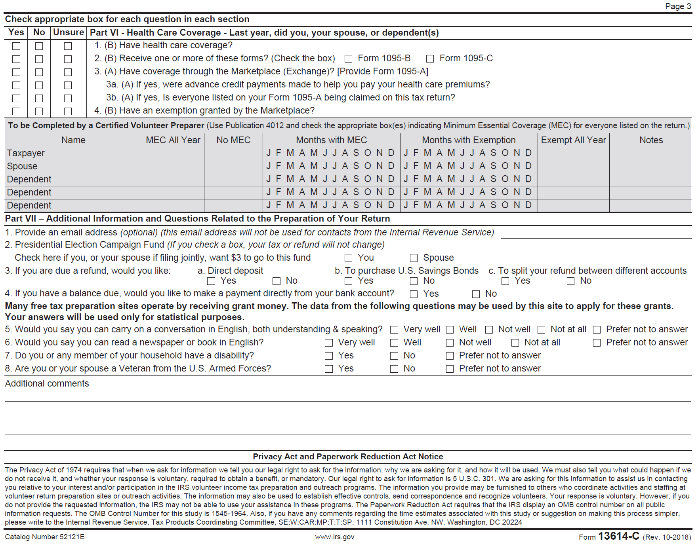
Intake Booklet Page 3
Counselor to complete shaded area
Notes:
Rarely see this completed!

Slide 12
Intake Booklet: Global Carryforward Consent
Consent #1: Global Carryforward
Allows TaxSlayer to carryforward taxpayer data to all active TCE/VITA Sites following year
Same-site carryforward available without consent
Taxpayer/spouse sign form if agree to consent
Preparer assigns PIN in e-file section
If consent denied no PIN required
Notes:
Extended Carryforward no longer available. Last year, for the 2018 filing season, carryforward from a 2016 return prepared at any still active Tax-Aide site was available on a pilot basis. It is NOT available for the 2019 filing season. Make sure taxpayer understands that if he/she goes to another TCE/VITA site for the 2020 tax season, they must sign the global consent form in order for the information to carryforward to the other site. If taxpayer agrees, preparer will assign PIN while completing e-file section of return
Same site carryforward. Same site carryforward will include more information than in the past.
For example, for the 2019 filing season, same site carry forward will include the Simplified method worksheet and Form 1099-Misc.
Both taxpayer and spouse must sign consent. If one denies, consent is denied. Taxpayer may take consent home with 8879 to secure signatures.

Slide 13
Intake Booklet: Relational Offices Consent
Consent #2: Relational Offices Consent
Allows TaxSlayer to share taxpayer data with AARP Foundation
Consent required to e-file any return
Taxpayer/spouse sign form if consent given
Preparer assigns PIN in e-file section
If consent denied return(s) must be paper filed
Taxpayer/spouse not required to sign if consent denied
No PIN entered if consent denied
Notes:
Relational Office:
To meet AARP Foundation low-income 50+ reporting needs, capture site data at the national level and provide uniform custom questions, AARP has implemented Relational Groups which requires an additional consent form
If Taxpayer elects not to disclose the information, the return MUST be filed by paper and TaxSlayer cannot provide the demographic data to the Foundation
If questions answered, allows TaxSlayer to share answers with AARP Foundation
Consent required to e-file either federal or state return
Both taxpayer and spouse must sign consent
If one denies, consent is denied
Taxpayer may take consent home with 8879 to secure signatures

Slide 14
Intake Booklet: Relational Office Consent Form
Security of Data
limited number of Foundation staff have access to data
Data collected will not include full Social Security number
Foundation staff will not have access to returns
Notes:
The Relational consent form found on page 5 of the booklet refers only to “VITA”. TaxSlayer will modify the form in the software to refer to “VITA/TCE.”
The data has been requested by the Foundation in the past. However, often the questions were modified at the site level making it difficult to collect accurate data. Using the relational EFIN will eliminate that problem
VITA sites have been successfully using the relational EFIN form for several years

Slide 15
Intake Booklet: Information Sharing Consent
Consent #3: Information Sharing Consent
Information used to determine taxpayer eligibility for free programs and services offered by AARP Foundation
Taxpayer/spouse sign form if consent given
Preparer assigns PIN in e-file section
Information shared
Name, address, email address, phone number and age
Adjusted gross income, household size and income
Refund allocation
If taxpayer declines, use “did not answer”
Notes:
Consent to share information is NOT required to e-file return
However, if taxpayer does not consent, the preparer must use “Did not answer” in order to e-file the return
Allow taxpayer/spouse to make decisions on consents
Both taxpayer and spouse must sign consent
If one denies, consent is denied
Taxpayer may take consent home with 8879 to secure signatures

Slide 16
Intake Booklet: Custom Questions
Answers required for all national questions in order to e-file
Did not answer is a choice
National questions cannot be changed
National questions set up and passed to Tax-Aide sites through the use of the Relational Office function
Notes:
Custom Questions: Include diversity and demographic questions to comply with AARP Foundation low-income 50+ reporting requirements and savings questions to help measure the Foundation’s strategic objectives

Slide 17
Intake Booklet: Remaining Questions
Preparer completes remaining questions in software
How much of the refund the taxpayer saved
Type of savings product used
Was the taxpayer present during return preparation
Preparer’s initials
Reviewer’s initials – according to your site procedures
Notes:
Three following questions are in tax software, but not in the Intake Booklet:
How much of the refund the taxpayer saved – Tax-Aide question
Type of savings product used – Tax-Aide question
Was the taxpayer present during return preparation – IRS question

Slide 18
Due Diligence During Interview Process
Ask sufficient and thorough questions to ensure accuracy and completeness of tax return
Verify accuracy of documents presented
Use good judgment when relying on oral or written statements
Second Counselor quality review required
Notes:
18
Counselors must exercise due diligence in preparation of tax returns
The preparer must make reasonable inquiries if the information furnished appears to be incorrect or incomplete
IRS defines due diligence as the return preparer ensuring the correctness of oral and written representations made by the taxpayer
From Pub 4491 lesson 1:
Generally you can rely on good faith for taxpayer information without requiring documentation as verification
However, exercise caution when taxpayers want to claim a refundable credit such as EIC or education credits, especially if these credits are maximized

Slide 19
Due Diligence During Interview Process
Ask questions if information appears incorrect, inconsistent, or incomplete
Counselors may not ignore information provided or independently known
Counselors must not knowingly prepare false returns
Notes:
19
The bell can not be unrung
If taxpayer tells counselor about income, it must be reported. For example:
Cash for self-employment work
Interest on checking account not reported on 1099-INT

Slide 20
Due Diligence During Interview Process
Consult with Local Coordinator if concerned with accuracy of documents or answers
Do not prepare return if interview results appear inaccurate, suspicious or inconsistent
Notes:
20

Slide 21
Due Diligence During Interview Process
Can rely in good faith on information from taxpayer without requiring documentation as verification
Returning taxpayer has usually established credibility
Notes:
Remind taxpayer (again) that they be able to provide records if IRS or state asks for them

Slide 22
Completed Interview
Once return complete either
Prepare return
Taxpayer returns with missing documents
Possible appointment
Refer to another Counselor if in scope for site but out of scope for interviewing Counselor
Advise taxpayer return is out of scope
Discuss with Local Coordinator
Return Intake Booklet and all documents to taxpayer
Notes:
If not comfortable with some in-scope tax situation, hand taxpayer off to more experienced counselor.

Slide 23
Intake/Interview and Quality Review Test
Form 6744
All Tax-Aide volunteers must pass both tests with 80% or better
Self-study training found in Pub 5101 provides training materials for self-study

Slide 24
Quiz 1
The taxpayer marked question on interest as “unsure”
Upon questioning taxpayer responds that did receive $6 as shown on their bank statement
What do you do?
Change answer to “Yes” and record the $6 on Intake Sheet to alert Quality Reviewer about interest

Slide 25
Quiz 2
A taxpayer says he is self-employed, but only documentation is some poorly handwritten notes and his answers during interview are inconsistent and evasive
What do you do?
Discuss situation with your Local Coordinator. You do not have to prepare a return if you are uncomfortable with the results of your interview

Slide 26
Quiz 3
A taxpayer does not have photo ID with them, but you know them personally
What should you do?
Talk to your Local Coordinator who can approve an exception to the rule, especially since the taxpayer is personally known to you

Slide 27
Quiz 4
A taxpayer does not have Social Security cards for two dependents but did bring a copy of last year’s return that was completed by a paid preparer
What do you do?
Discuss situation with Local Coordinator to determine if can use a copy of last year’s return to confirm social security numbers

Slide 28
Screening and Interviewing

